Slide 1

Prediction Of CO2 Emissions By Country Using IBM Watson
By Team
MD ADEEB FARHAN
AMULYA VENISHETTY
PUNNAM RAJASHEKAR REDDY
KOTTE BHAGYALAXMI

Slide 2
PROJECT OBJECTIVES
Knowledge on Machine Learning algorithms
Knowledge on Python Language with Machine Learning
Knowledge on Statistics,Graphs and their relations
Real Time Analysis of Project
Building an ease of User Interface(UI)
Navigation of ideas towards other projects(creativeness)

Slide 3
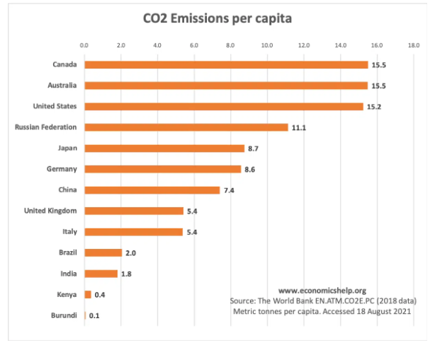
INTRODUCTION
Carbon emissions and environmental protection issues have brought pressure from the international community during Chinese economic development. Recently, Chinese Government announced that carbon emissions per unit of GDP would fall by 60–65% compared with 2005 and non-fossil fuel energy would account for 20% of primary energy consumption by 2030.The Beijing-Tianjin-Hebei region is an important regional energy consumption center in China, and its energy structure is typically coal-based which is similar to the whole country.
Therefore, forecasting energy consumption related to carbon emissions is of great significance to emissions reduction and upgrading of energy supply in the Beijing-Tianjin-Hebei region. Thus, this study thoroughly analyzed the main energy sources of carbon emissions including coal, petrol, natural gas, and coal power in this region.

Slide 4
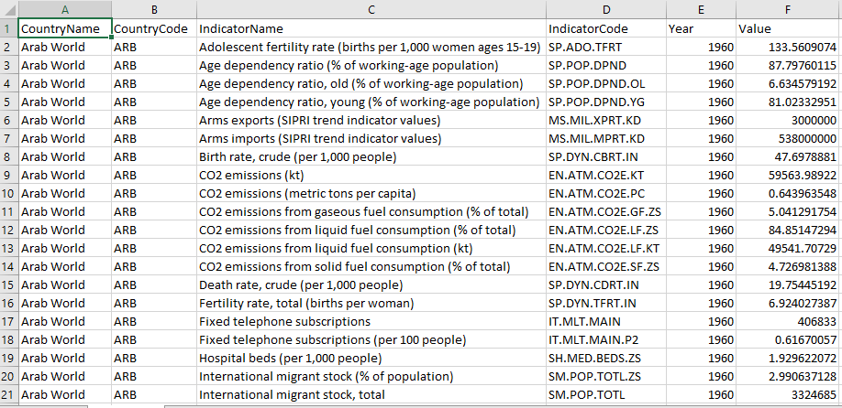
DATA To perform the required algorithms, operations on the data, we collected dataset from the source Kaggle. https://www.kaggle.com/ashukr/exploring-co2-emission?select=Indicators.csv Few dataset attributes are: 1.CountryName 2.CountryCode 3.IndicatorName 4.IndicatorCode 5.Year

Slide 5
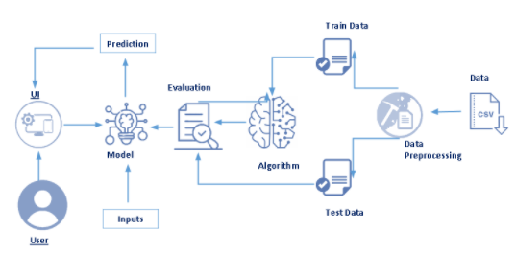
TECHNICAL ARCHITECTURE

Slide 6
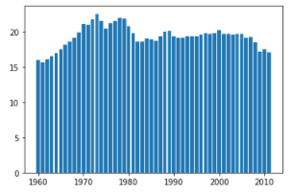
DATA VISUALISATION
Data visualization is where a given data set is presented in a graphical format. It helps the detection of patterns, trends and correlations that might go undetected in text-based data.Understanding your data and the relationship present within it is just as important as any algorithm used to train your machine learning model. In fact, even the most sophisticated machine learning models will perform poorly on data that wasn’t visualized and understood properly.
To visualize the dataset we need libraries called Matplotlib and Seaborn.The Matplotlib library is a Python 2D plotting library which allows you to generate plots, scatter plots, histograms, bar charts etc.

Slide 7
MODEL BUILDING
There are several Machine learning algorithms to be used depending on the data you are going to process such as images, sound, text, and numerical values. The algorithms that you can choose according to the objective that you might have may be Classification algorithms are Regression algorithms.
Example: 1. Linear Regression.
2. Logistic Regression.
3. Random Forest Regression / Classification.
4. Decision Tree Regression / Classification.
You will need to train the datasets to run smoothly and see an incremental improvement in the prediction rate.
Now we apply the Random forest regressor algorithm on our dataset.
A Random Forest is an ensemble technique capable of performing both regression and classification tasks with the use of multiple decision trees and a technique called Bootstrap and Aggregation, commonly known as bagging. The basic idea behind this is to combine multiple decision trees in determining the final output rather than relying on individual decision trees.

Slide 8
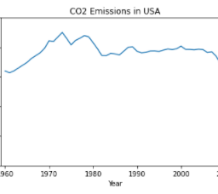
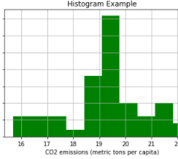
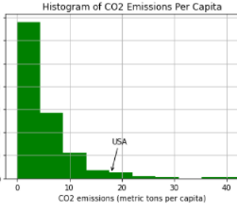
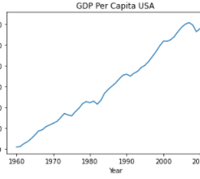
VISUALISATION OF GRAPHS

Slide 9
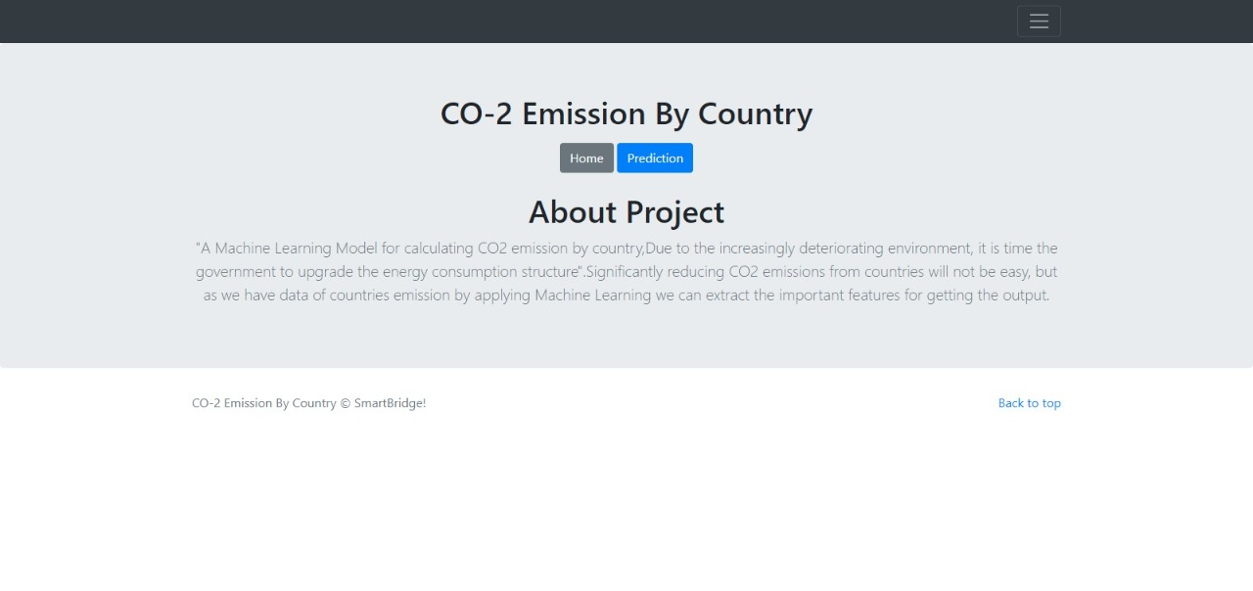
Predicting the results
This is the home page where a brief introduction is given about the CO-2 Emission By Country. To see the prediction you need to click on prediction. You will be navigated to the prediction page.

Slide 10
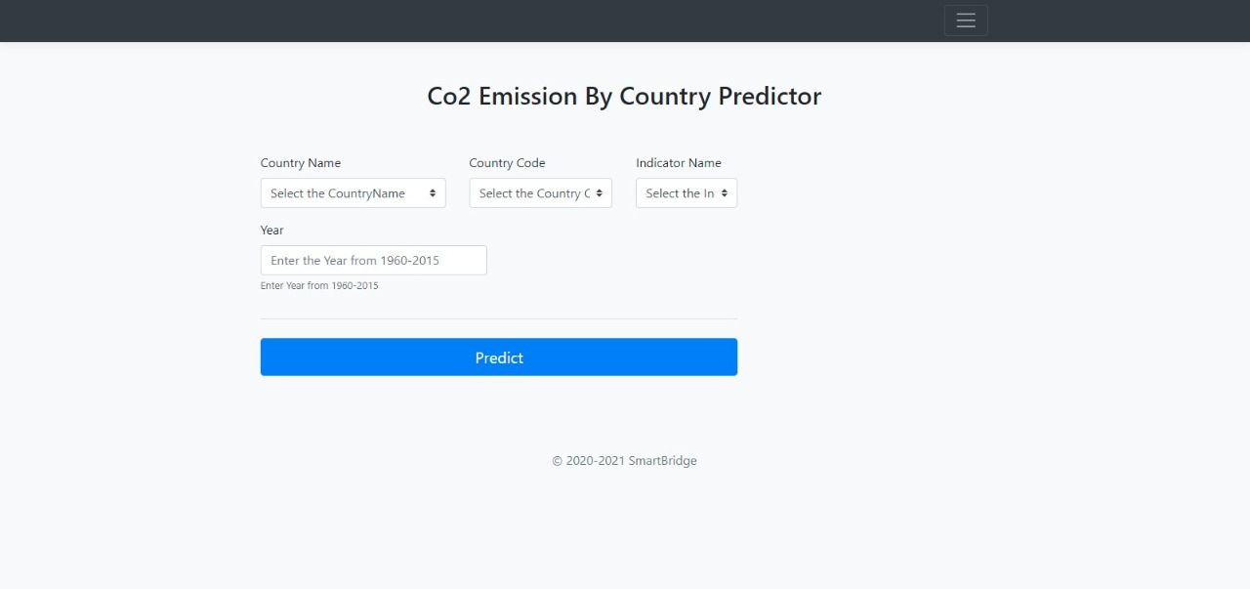
Predicting the result Here in the prediction page we get to choose the country for which we want to predict the emission, enter the values in the required areas in the mentioned ranges. Then click on predict to see the predicted result.

Slide 11

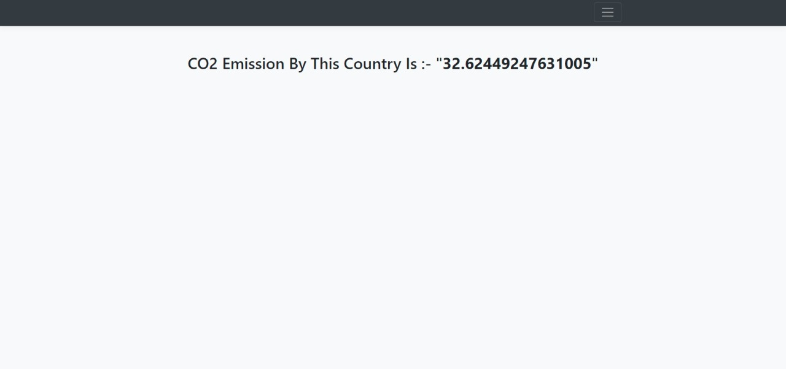
FINAL OUTPUT

Slide 12
CONCLUSION This can be applied to predict CO2 emissions from energy consumption which can give us more accuracy . This model is used to monitor electrical energy and burning coal which affect the amount of CO2 emitted. It can be concluded that with the high accuracy of the prediction model, then the lower RMSE value must be obtained.For better results we used Random forest regressor algorithm.

Slide 13
THANKYOU

